Slide 1
OPTIONAL RUNNING HEADER IS ALL CAPS
I have compiled an installer and placed it on the network
Drive…However, the network is slow. So the fastest is to
Download directly from the website
Tip: To navigate between the first level copy and the first level bullet, use the Indent and Outdent button on the Home Ribbon.
Once you are on the second, and third level bullets, you can Tab and Shift-Tab to go back and forth between the bullet levels.
32 Bit:
Download the 2014 LVRTE from here:
http://www.ni.com/download/labview-run-time-engine-2014/4887/en/
64 Bit:
http://www.ni.com/download/labview-run-time-engine-2014/4889/en/

Slide 2
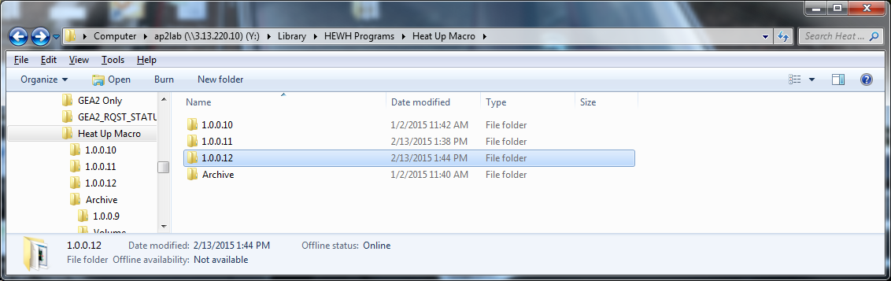
OPTIONAL RUNNING HEADER IS ALL CAPS
Run the Macro:
Navigate back to the below location
Find the latest version
Double Click and run the application
(You can copy/paste the file directory somewhere on your computer…just know there are occasional updates)
Tip: To navigate between the first level copy and the first level bullet, use the Indent and Outdent button on the Home Ribbon.
Once you are on the second, and third level bullets, you can Tab and Shift-Tab to go back and forth between the bullet levels.

Slide 3
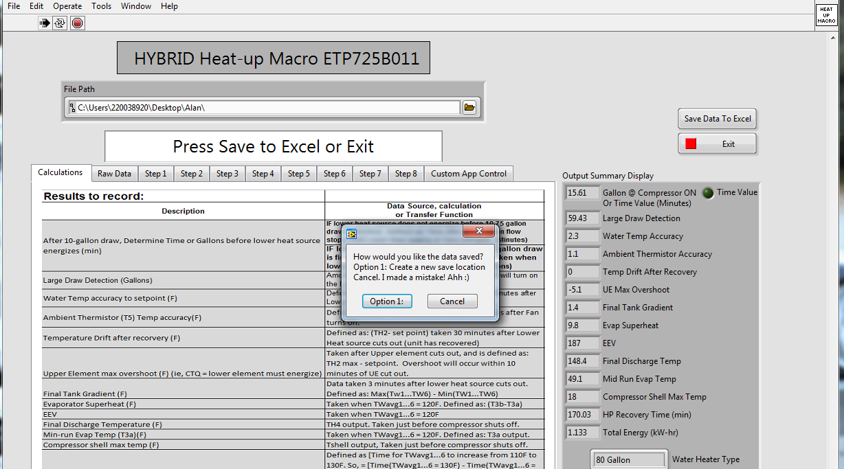
OPTIONAL RUNNING HEADER IS ALL CAPS
Run the Macro:
Create a blank excel file
Click Option 1:
Find the blank excel file you created.
Click “Update” when excel prompts you.
Tip: To navigate between the first level copy and the first level bullet, use the Indent and Outdent button on the Home Ribbon.
Once you are on the second, and third level bullets, you can Tab and Shift-Tab to go back and forth between the bullet levels.

